Slide 1
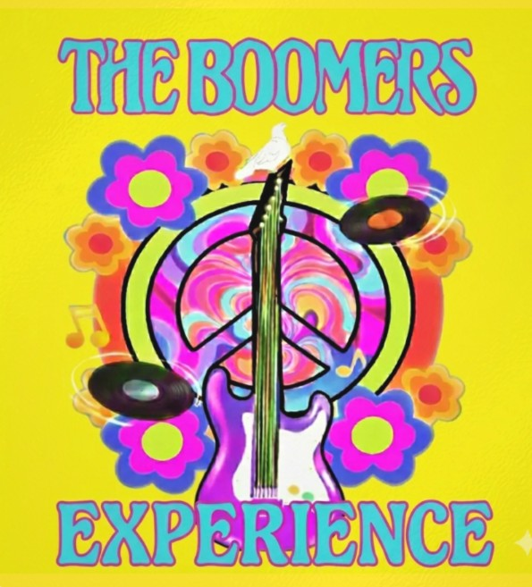



"Groovy tunes, non-stop energy, and music that will get you on your feet! 🎸✨ Experience the ultimate 60s and early 70s musical throwback!"

Slide 2
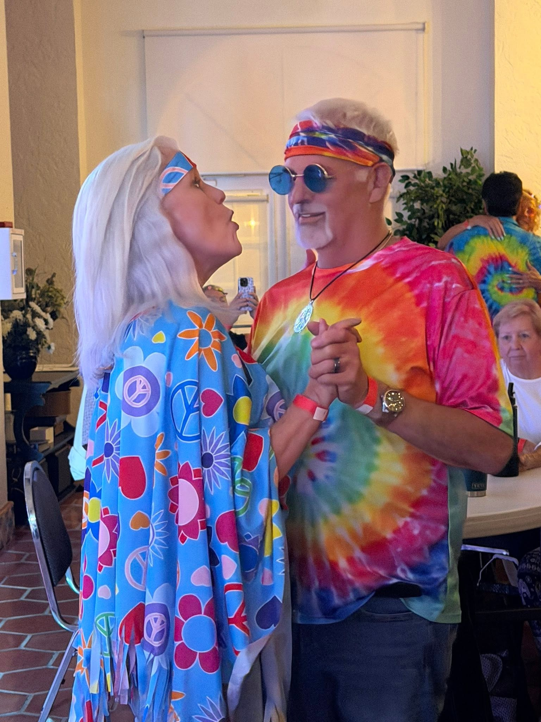
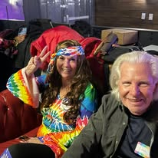
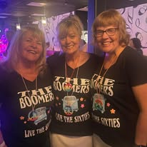
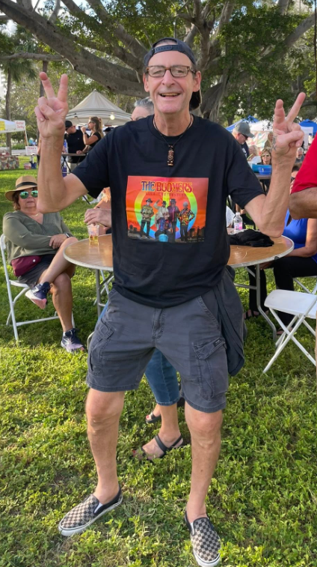
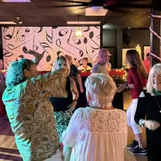
The Boomers Experience: A High-Energy Sonic Time Machine
Get ready to twist, shout, and step back in time with The Boomers Experience, the premier local cover band dedicated to keeping the spirit of the 1960s and early '70s alive. Delivering an electrifying, high-energy live show, the band boasts a massive repertoire covering many legendary artists of the era—including The Beatles, The Rolling Stones, Cream, The Doobie Brothers, Santana, The Monkees, Johnny Rivers, The Who, and The Kinks!
More than just a concert, a performance by The Boomers Experience is a fully immersive, crowd-participatory event; dressed in vintage threads, the band brings an infectious energy that gets audiences singing along and packing the dance floor. Fans are always encouraged to dust off their grooviest outfits to join in on the retro fun. Perfect for local venues, community festivals, and private parties, The Boomers Experience guarantees an unforgettable, feel-good celebration of the greatest era in rock history.
Ctrl + Click here for song list!

Slide 3
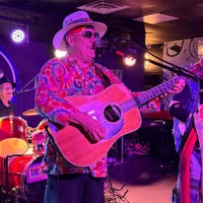
Bob Cary
Lead Vocals
Acoustic Guitar
Meet the Boomers

Slide 4
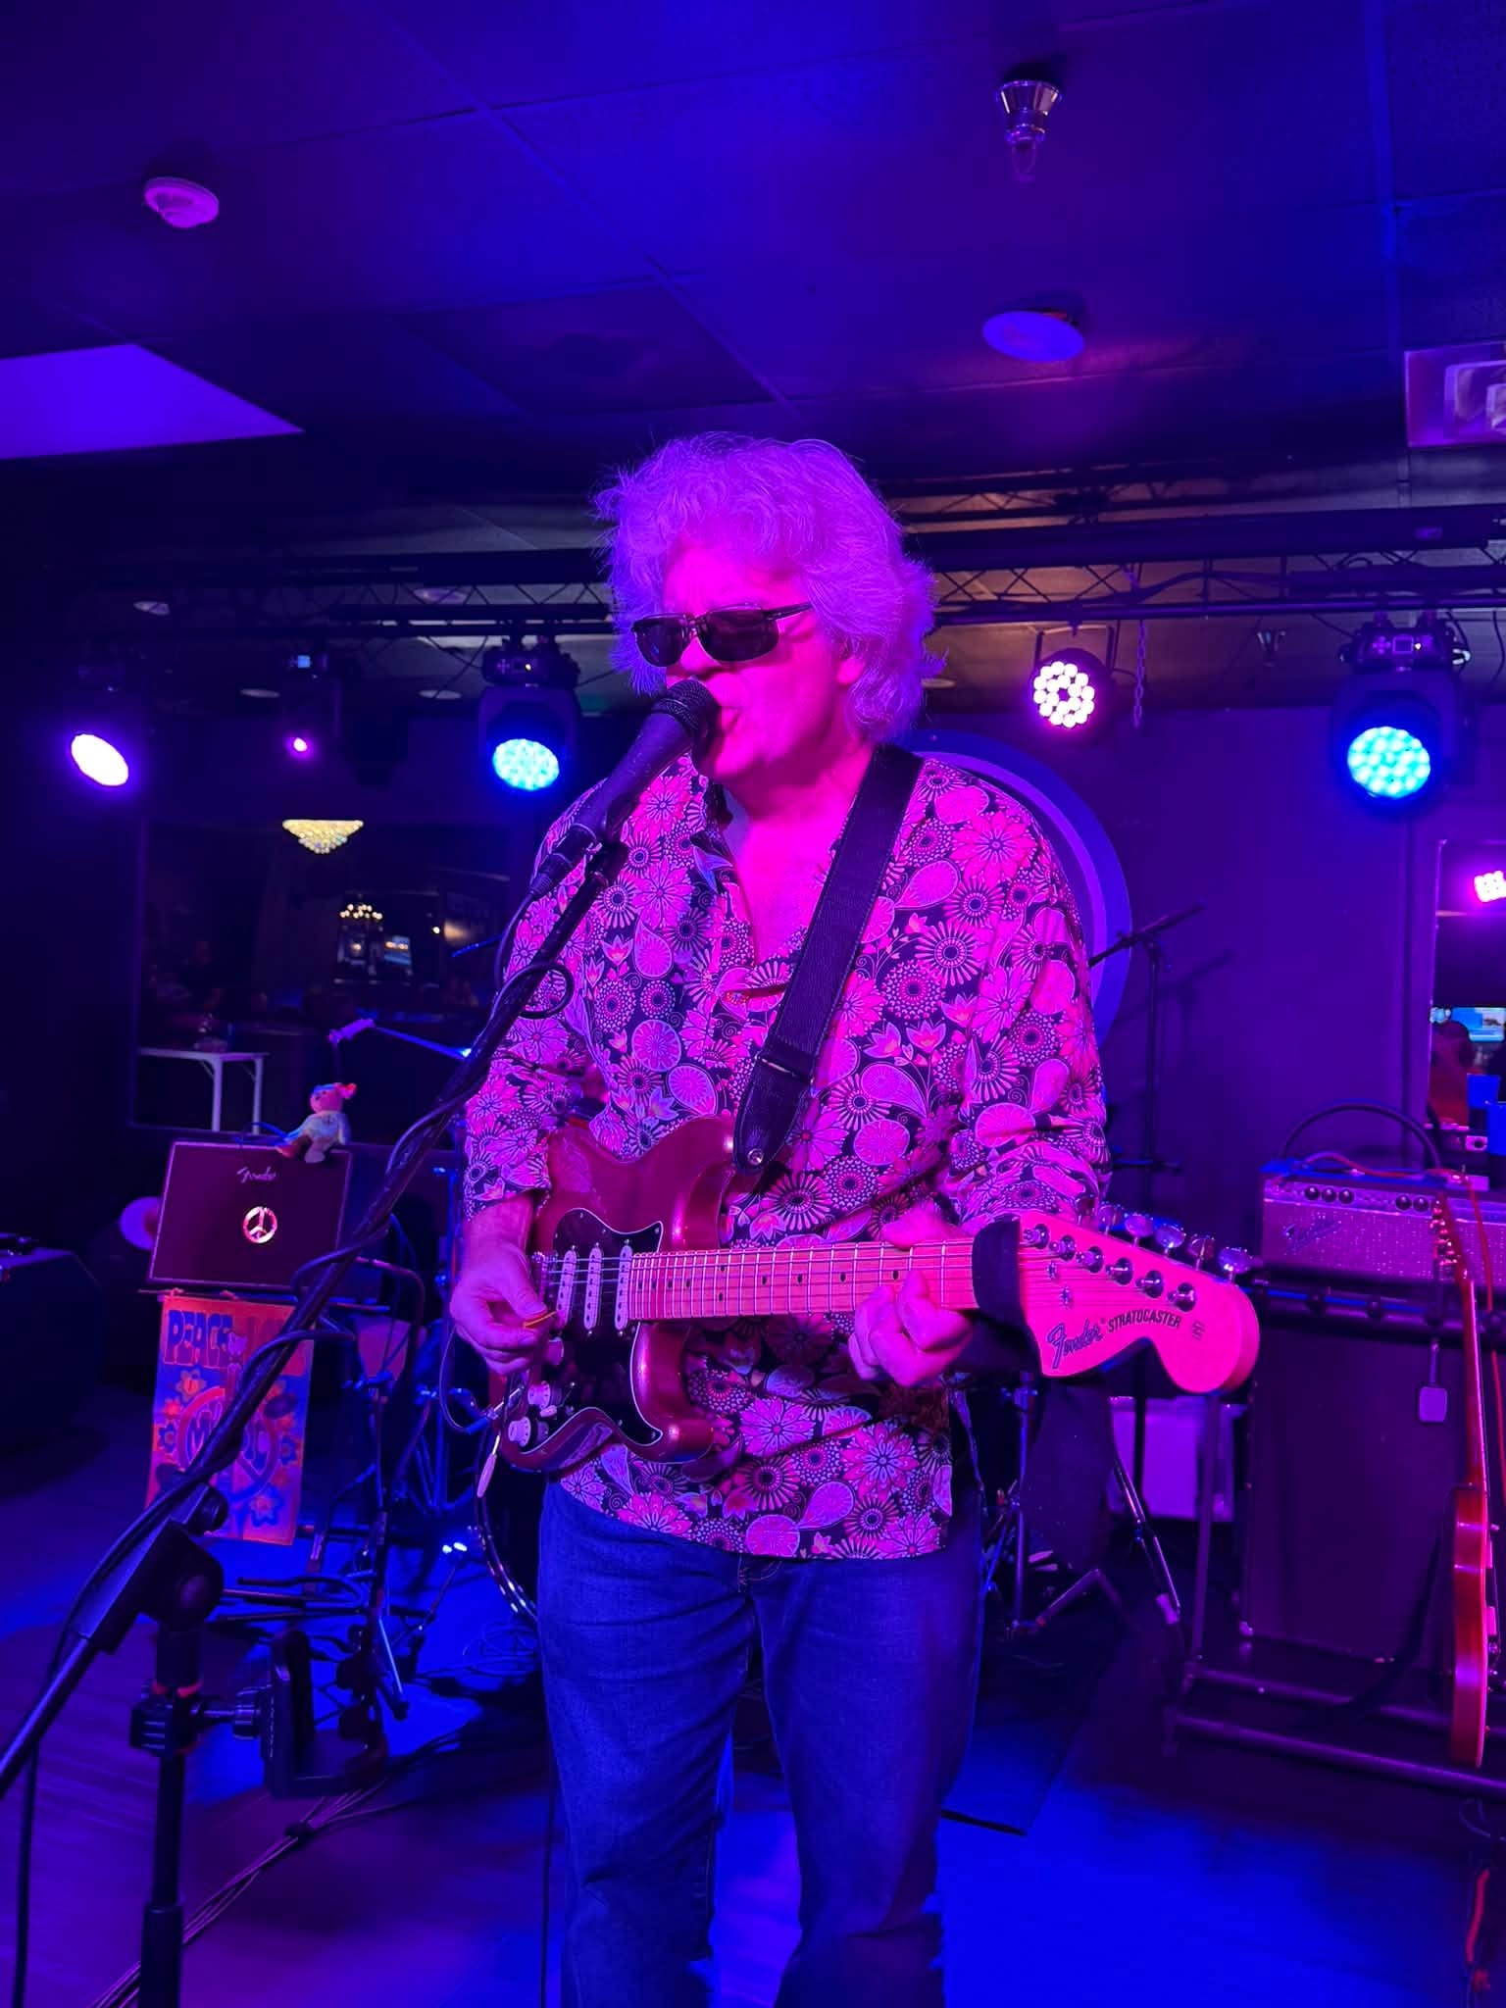
Meet the Boomers
Micah Scoville
Electric Guitar
Vocals

Slide 5
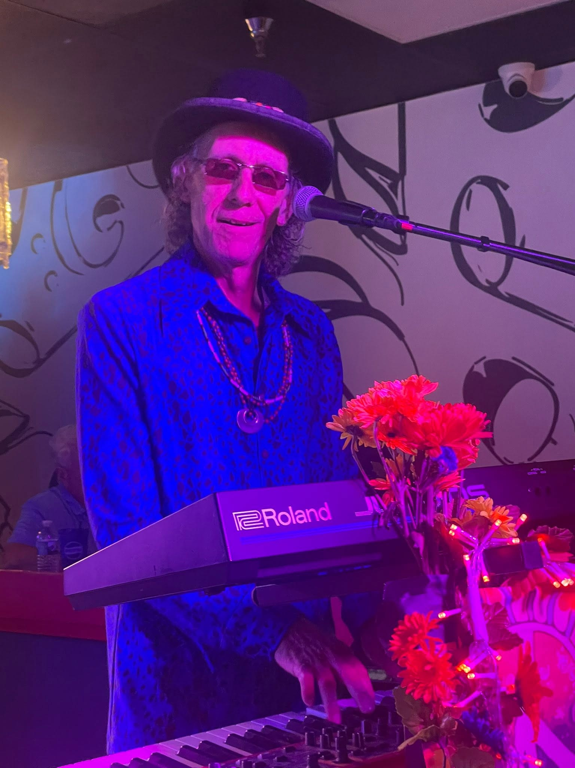
Gordon Flash
Keyboard
Vocals
Meet the Boomers

Slide 6
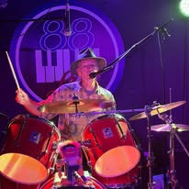
Meet the Boomers
Mike Kennedy
Drums Vocals

Slide 7
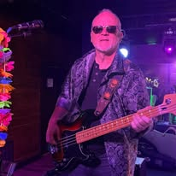
Meet the Boomers
Todd “T-Bone” Bohlmann
Bass Guitar Vocals

Slide 8
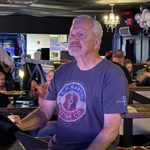
Meet the Boomers
Mike Brennard
Sound Engineer

Slide 9

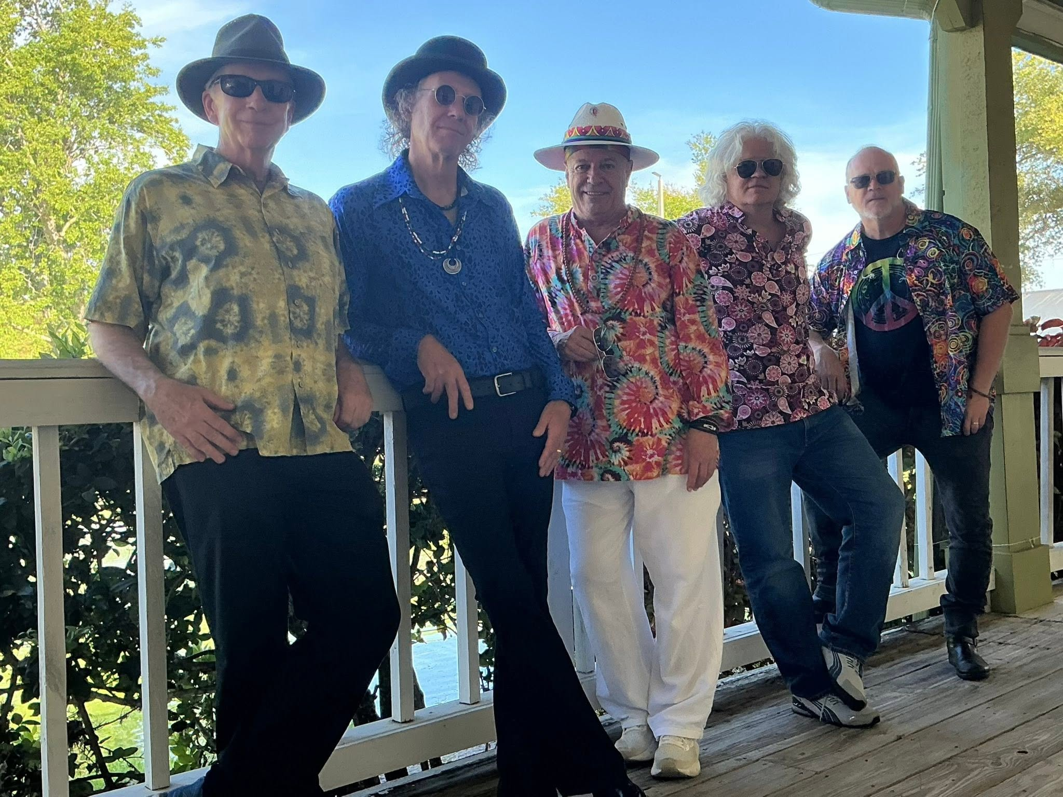


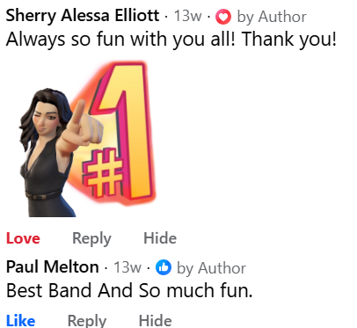

For Information on Booking Your Boomers Experience:
Todd Bohlmann
269-615-2320
ttbohlmann@msn.com

Slide 10
